Slide 1

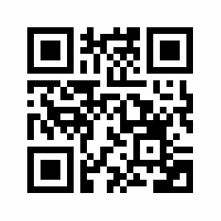
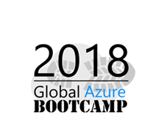
Containerize Your World
Daniel Scott-Raynsford
Continuous Delivery Practice Lead @ IAG NZ
Microsoft Cloud & Datacenter Management MVP
Getting Started with Containers using Azure Container Service, Docker & Kubernetes
Workshop Content:
https://bit.ly/2qNscu9

Slide 2
Agenda
What are Containers?
Container Images
Orchestrators & Kubernetes
Azure Container Service

Slide 3

What are Containers?

Slide 4
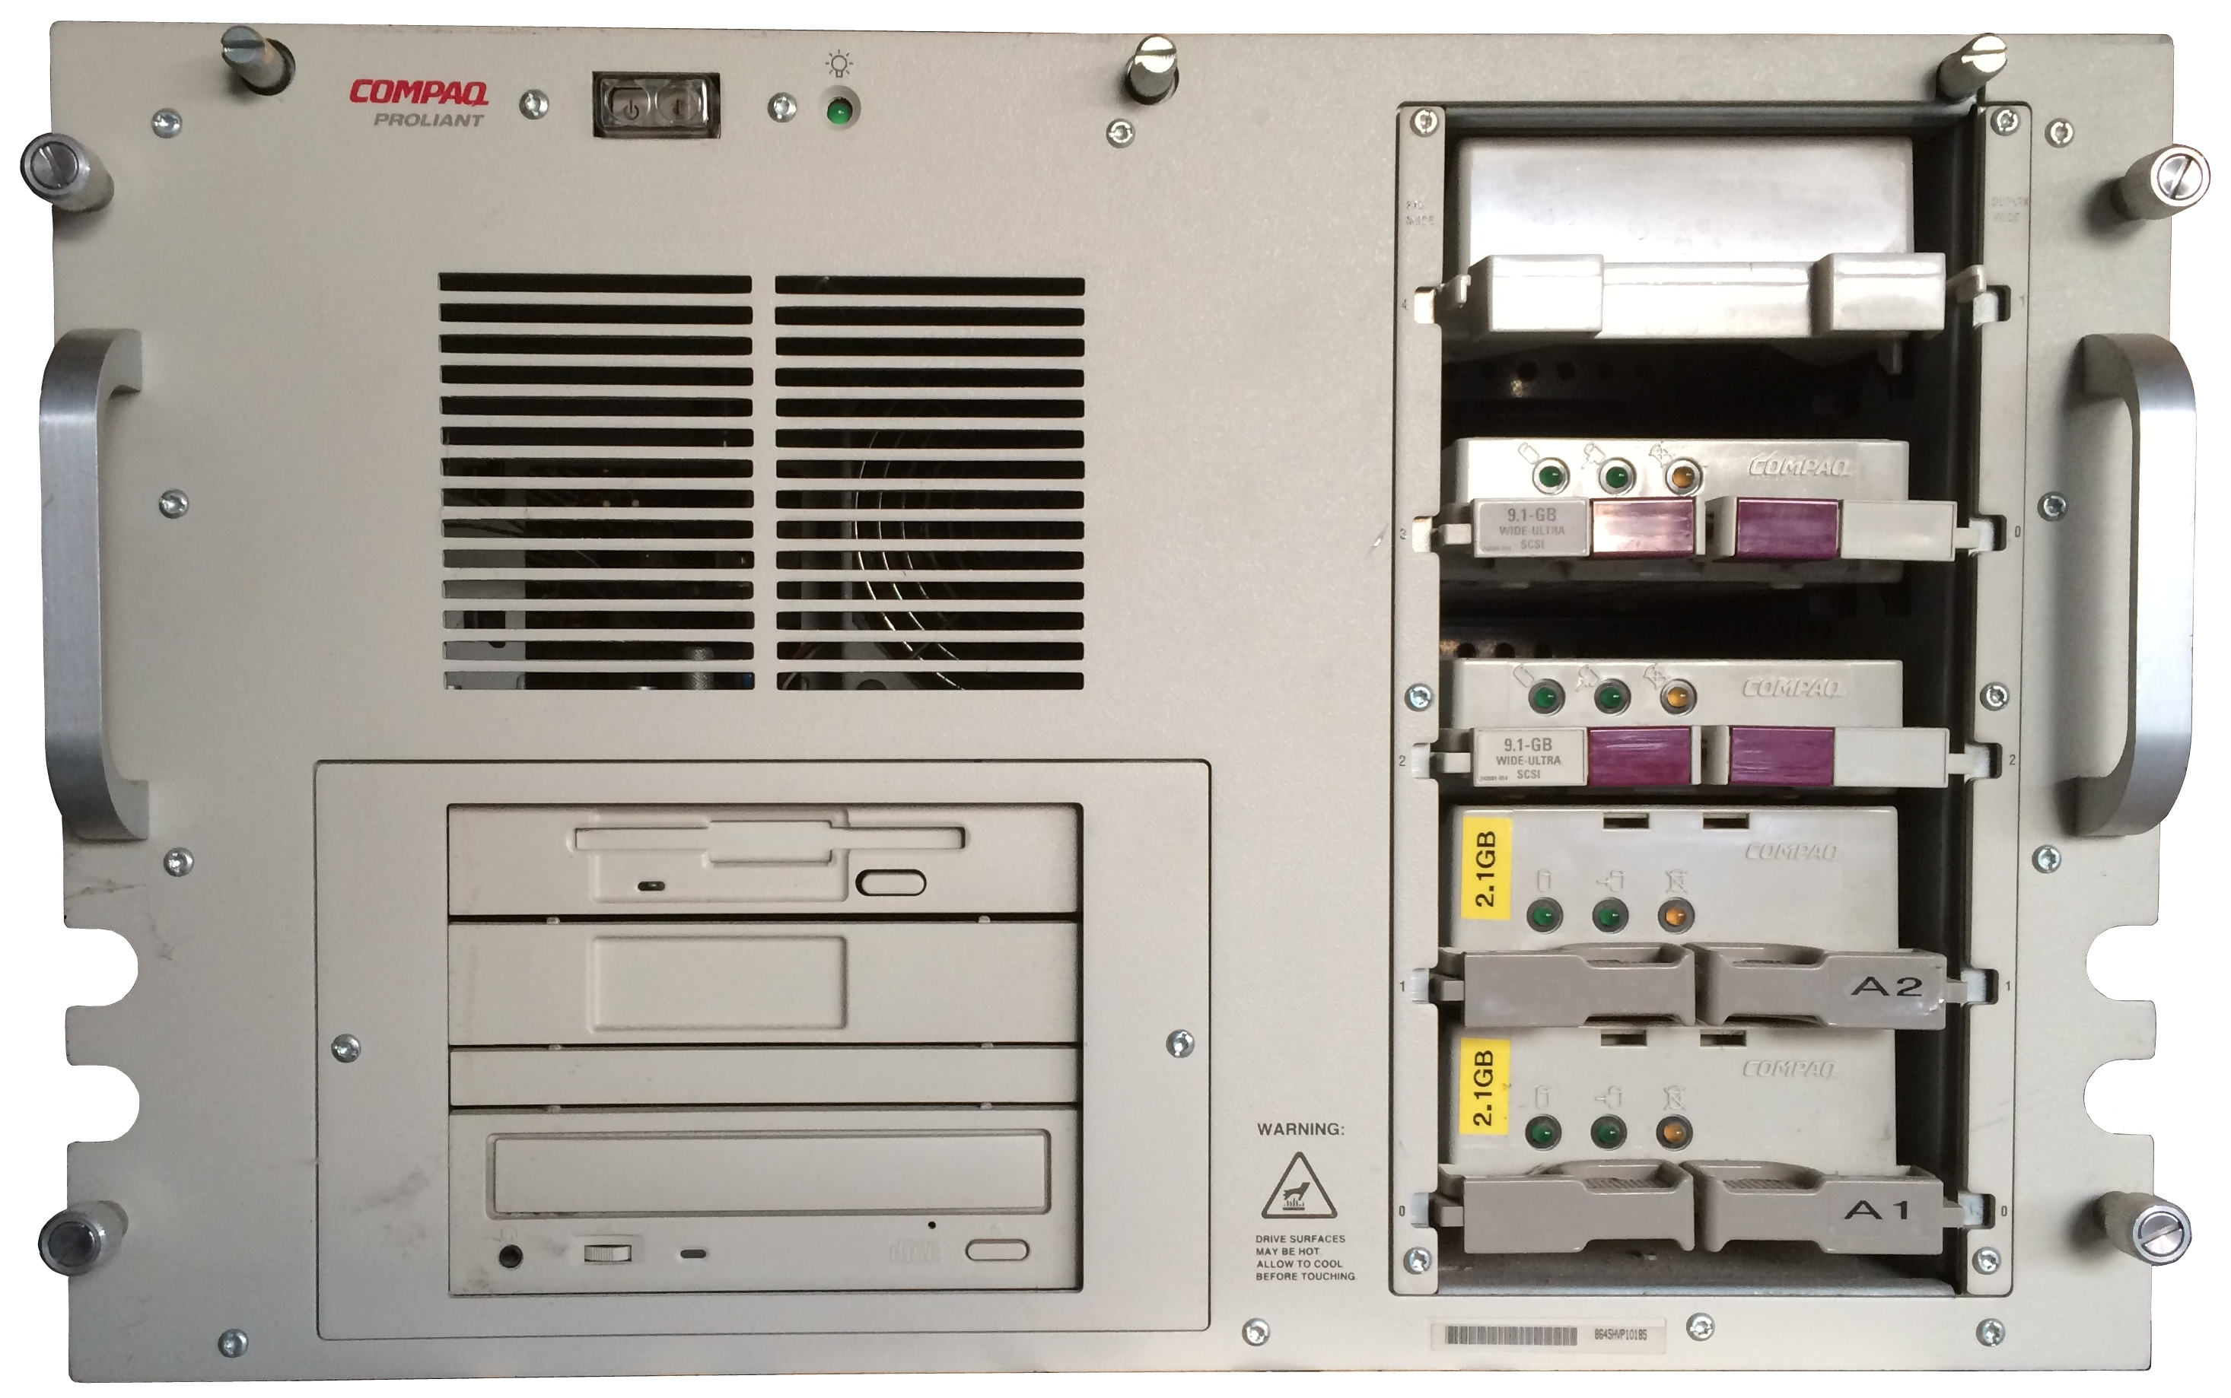

1997

Slide 5
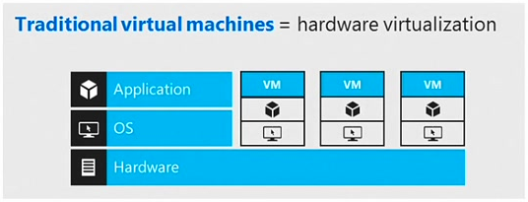
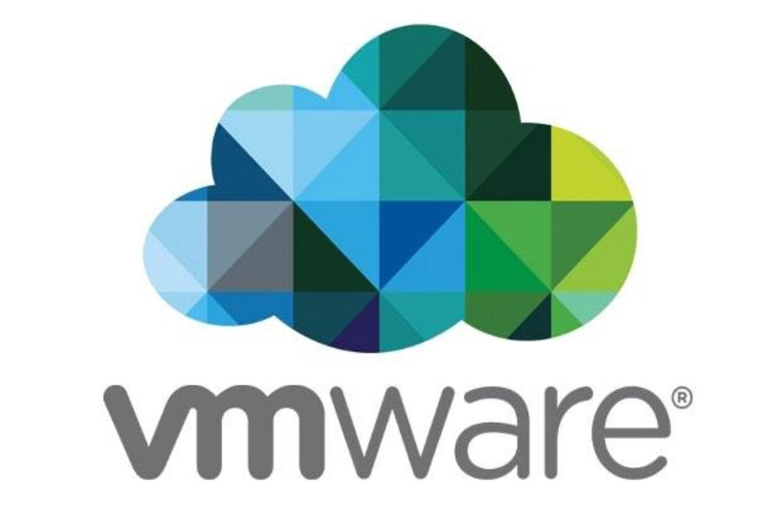
1999

Slide 6
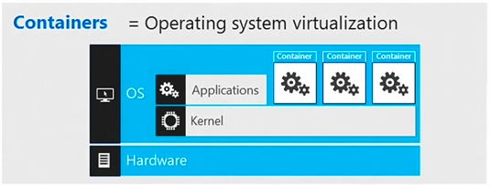
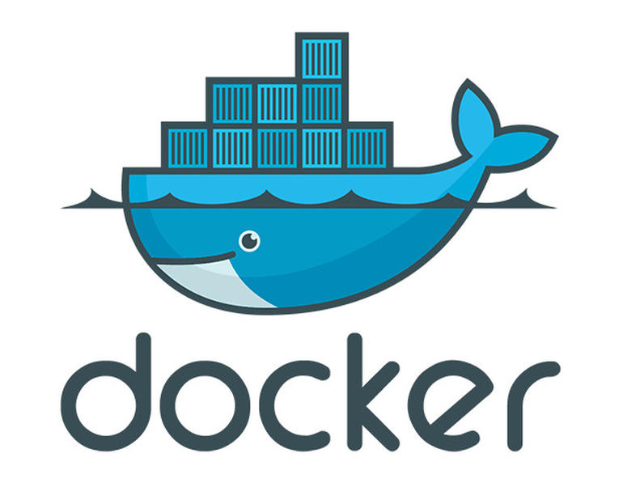
2014

Slide 7
Virtualization vs. Containers

Slide 8

Run Containers In
On-Premises Datacentre
Physical/Virtual
Linux
Windows Server 2016+
Azure Stack
Azure Compute (VM)
Azure Container Instance
Azure App Service
Azure Container Service
Azure Kubernetes Service
Service Fabric
And others…

Slide 9


Container Hosts
+
+
Linux Containers
Windows Server Containers
Hyper-V (Isolated) Containers

Slide 10

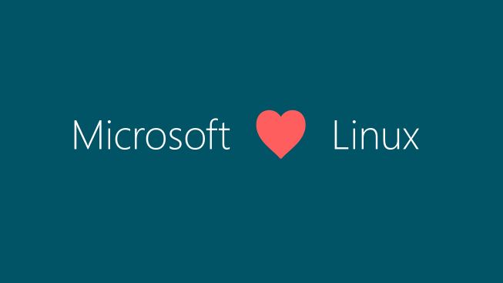
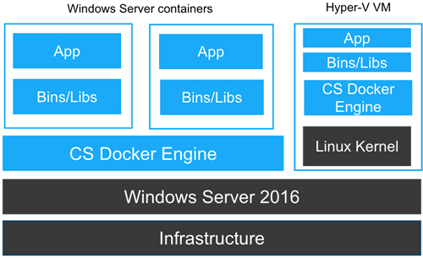
Container Hosts Cont.
+
Windows Server Containers
Hyper-V (Isolated) Containers
Linux Containers

Slide 11
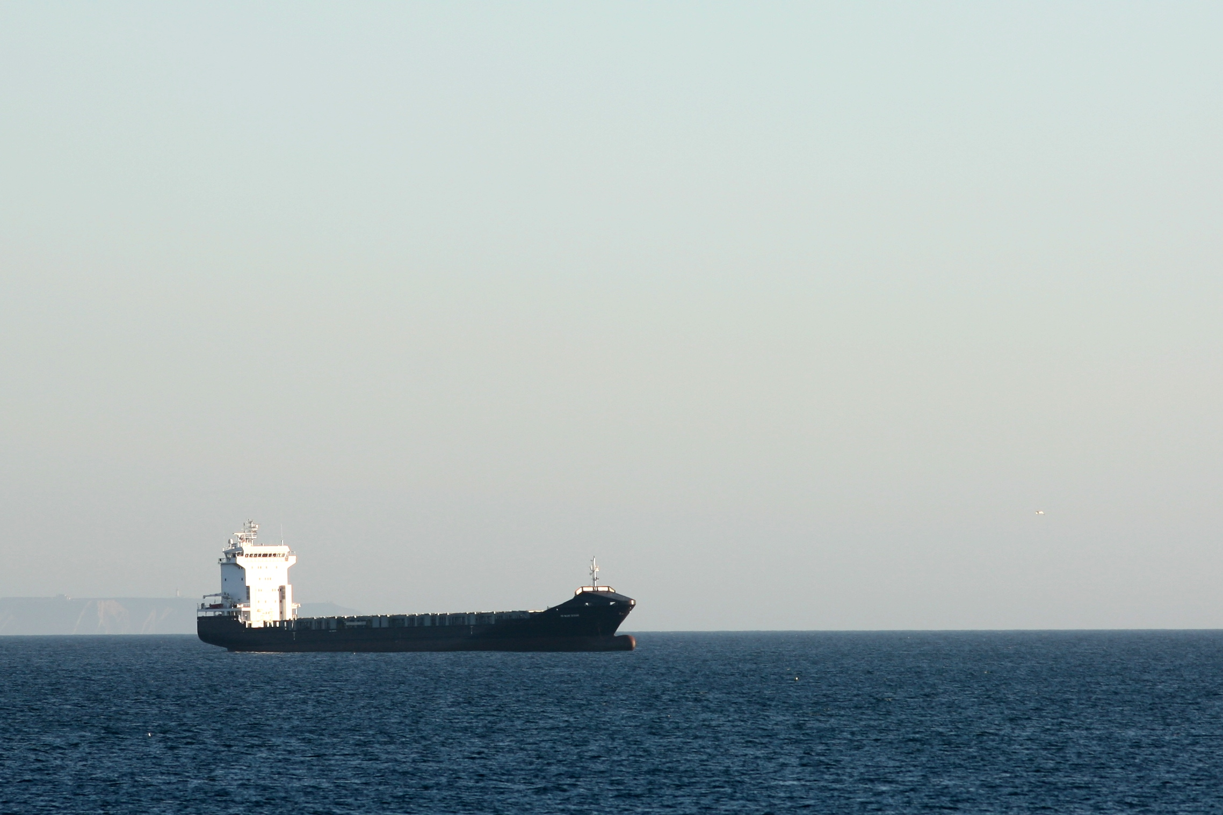
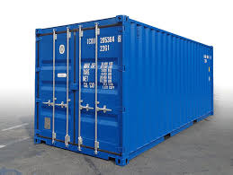
Container Images

Slide 12
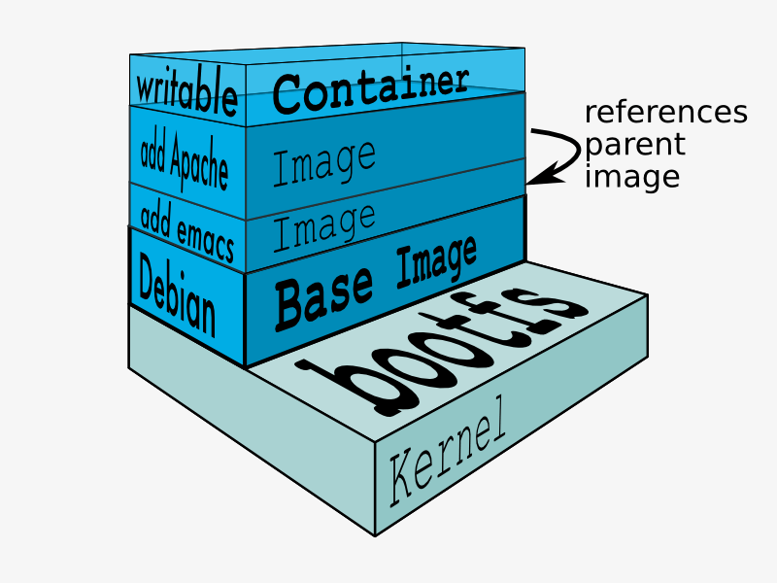
Docker Images
Base Image
Many Linux
Windows Server Core
Nano Server
References Parent
Differences Only

Slide 13
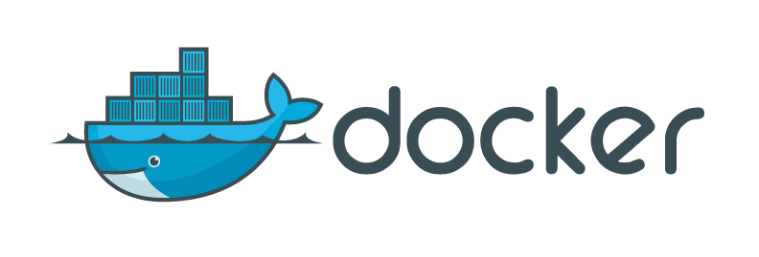

Container Registry
On Container Host
Only accessible on host
Docker Hub
Public & Private
Azure Container Registry
Private

Slide 14
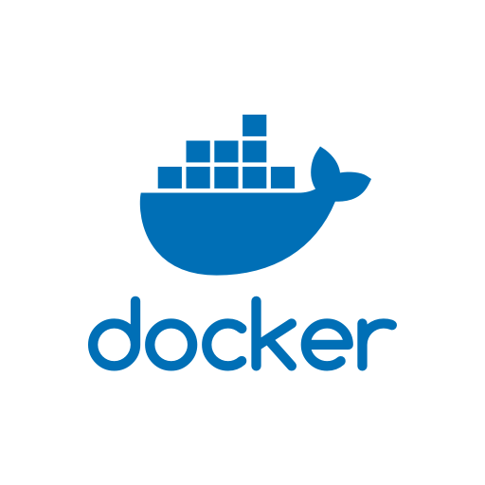


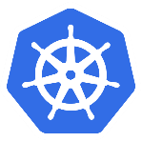


Container Workflow
Build
Publish
Orchestrate
Run

Slide 15

Orchestrators & Kubernetes

Slide 16
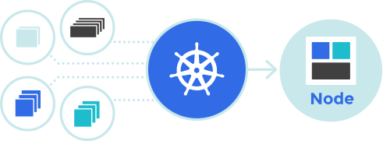
Kubernetes = Container Orchestrator
Developed by Google
Free, Open-Source
Runs Anywhere
On-premises, Cloud (Azure Container Service), Other Cloud Providers
Other Orchestrators
DC/OS (Mesos), Swarm (Docker), Cattle (Rancher) and others

Slide 17
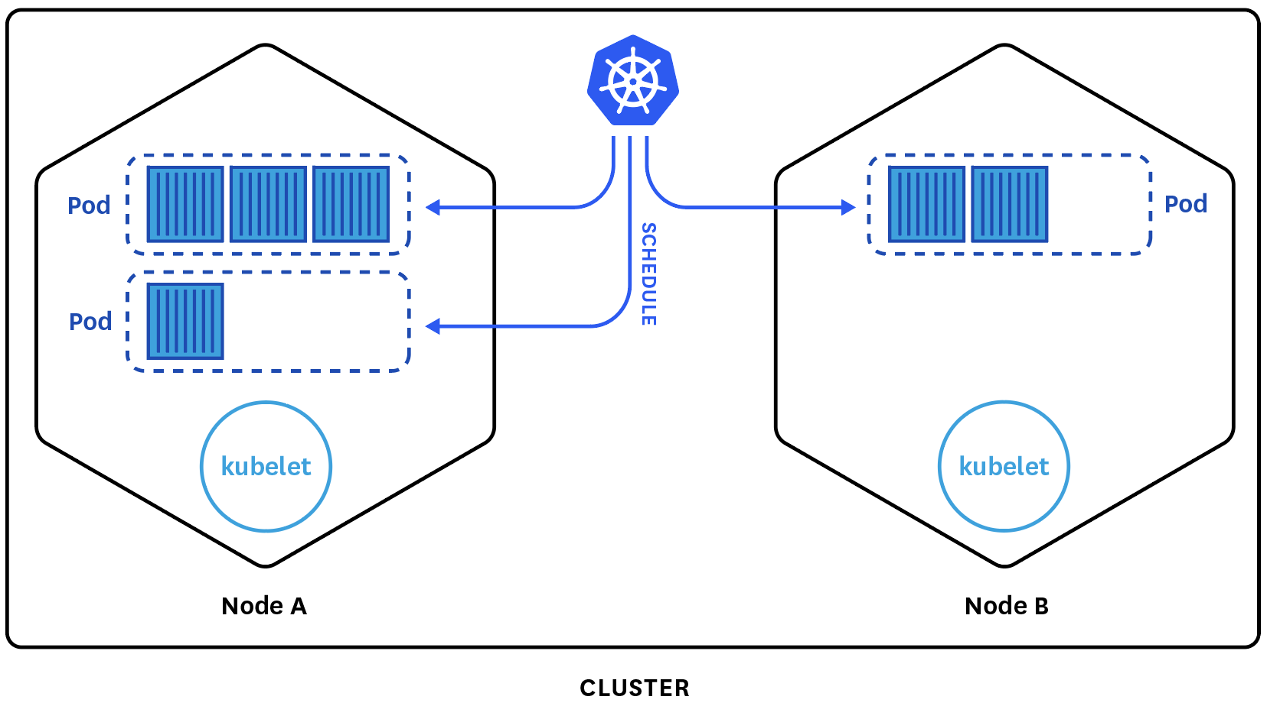
Kubernetes Cluster

Slide 18

Master
Manages & Monitors Nodes
Schedules Pods
Can be made Highly Available
Container Host (Docker)

Slide 19
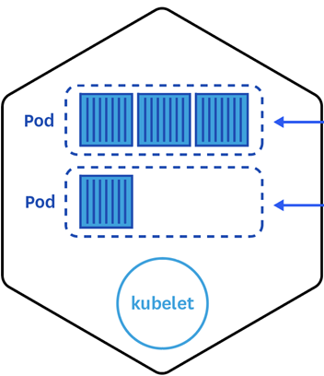
Nodes
Container Host (Docker)
Windows or Linux
Can be Hybrid (!)
Dynamic
Hosts
One Kubelet
One or more Pods

Slide 20

Pods
A Unit of Deployment
One or more Containers
Storage Resources
Network IP Address
Managed by Kubelet

Slide 21
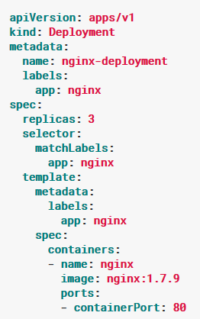
Deployment
Used to Deploy Application
Stored on Master
Defines Desired State
Configure using Manifest File
Can be Modified/Updated
Deployment Manifest for Nginx

Slide 22
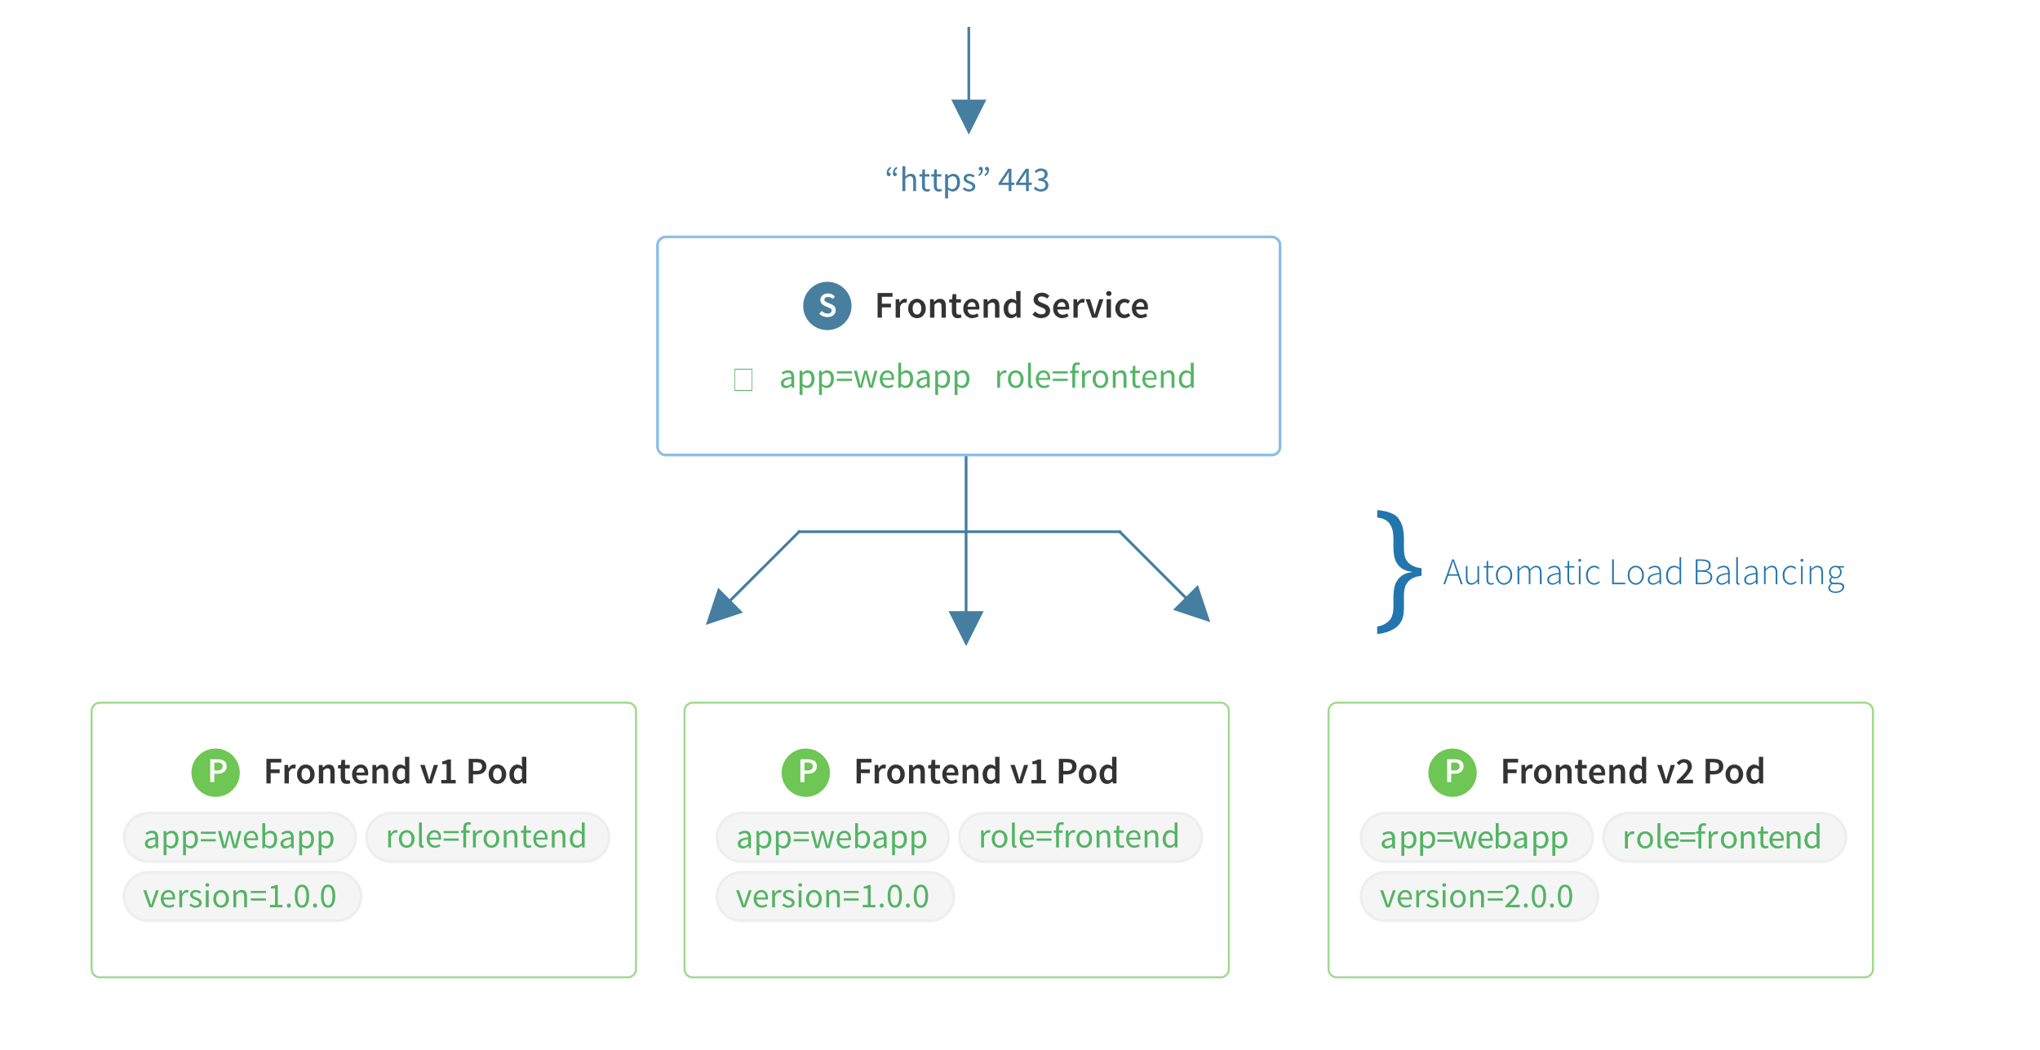
Service
Defines External Access to Pods
Maps Port to Target Port
Abstraction
Labels

Slide 23
kubectl.exe
Kubernetes CLI
Manages Kubernetes Clusters
Connects to Master
Uses HTTPS REST API
Username + SSH Key

Slide 24
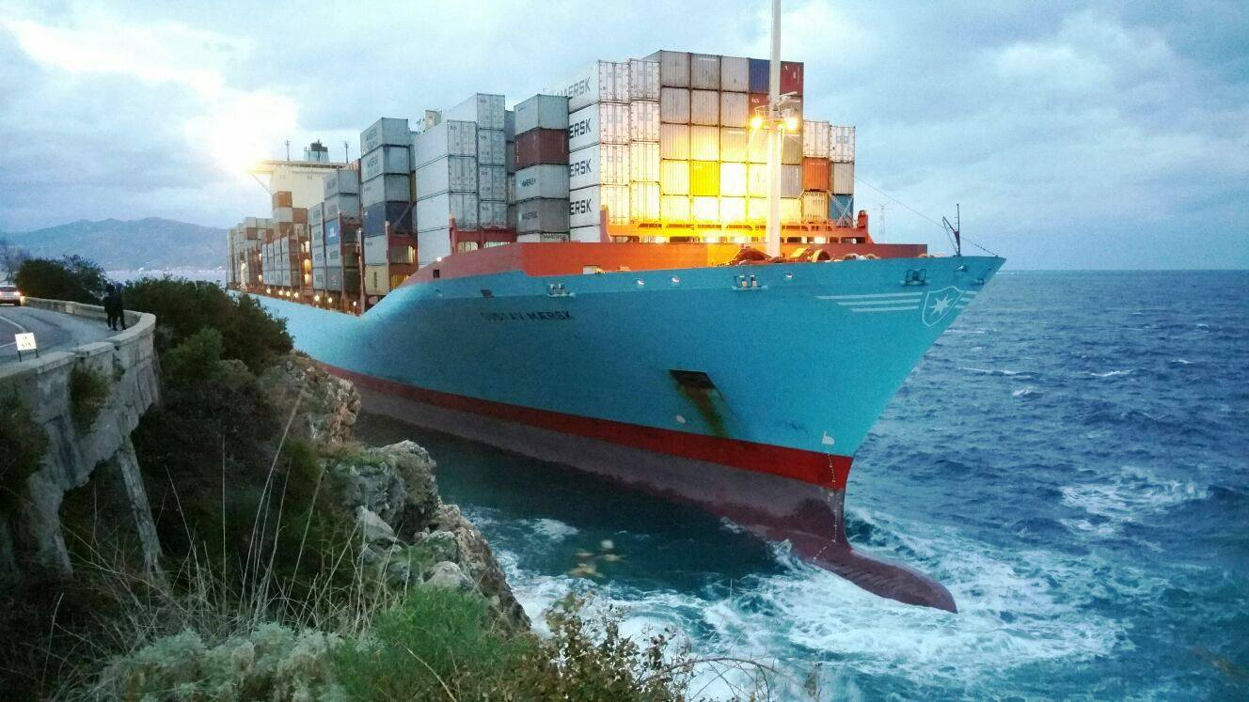
Azure Container Service

Slide 25
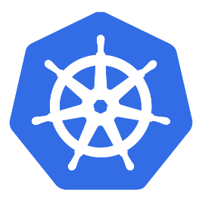
Azure Container Service (ACS)
Deploys Unmanaged Container Cluster
Azure Kubernetes Service (AKS) creates Managed Cluster (Preview)
Orchestrators
Kubernetes
DC/OS (Mesos)
Swarm (Docker)

Slide 26
Azure Kubernetes Service (AKS) Preview
Deploys Managed Kubernetes Cluster
Reduced Management
In Preview

Slide 27

Features of ACS
Self-healing
Horizontal scaling
Service discovery and load balancing
Automated rollouts and rollbacks
Secret and configuration management
Storage orchestration
Batch execution

Slide 28


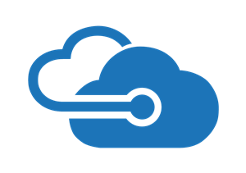
Deploy ACS Using
Azure Portal
Azure Resource Manager Template
Azure PowerShell Cmdlets
Azure CLI
Programatically via Azure API

Slide 29
ACS Deploy Options
Orchestrator Type
DNS Prefix
Master Credentials (using SSH)
Number of Master Nodes
Number of Nodes (Agents)
Agent, Master VM & Disk Size

Slide 30
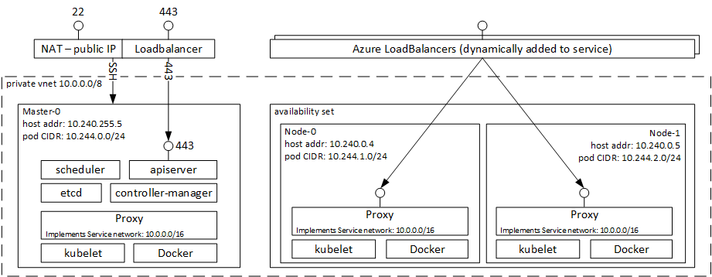
ACS Kubernetes Cluster

Slide 31
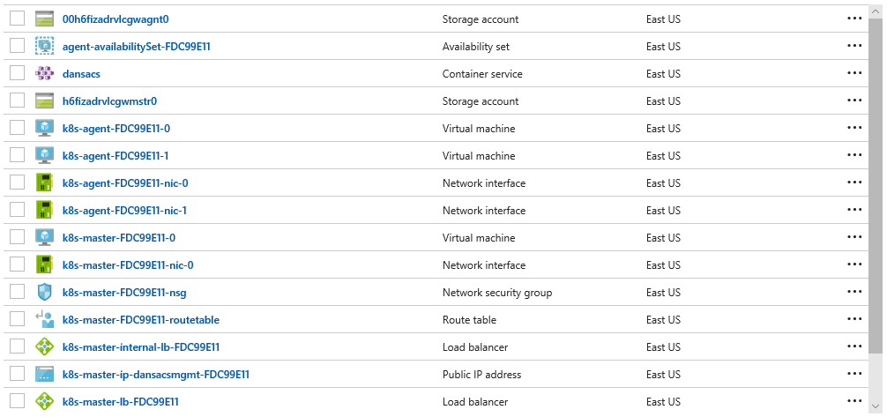
Cluster Resources

Slide 32

Feedback Form – Your Feedback is Appreciated
https://bit.ly/2JdkujQ

